Slide 1
Deep Fakes In Machine Learning and Deep Learning:
By Karan Ajay Pisay

Slide 2
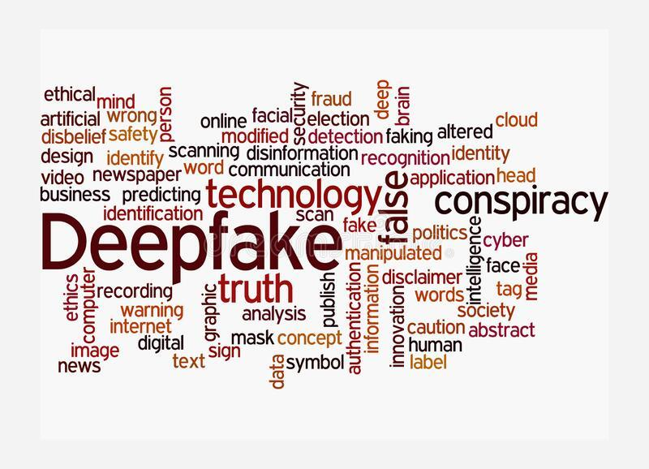
What is Synthetic Media and Deepfakes?
Also known as AI-generated media, generative media, and personalized media. Any media that has been created or modified using algorithms, particularly artificial intelligence algorithms. Synthetic media is a type of artificial imagination.
Deepfakes are image, video, text and sound creation techniques based on artificial intelligence. They're used to combine and overlay existing photos, videos, and soundtracks with forged material.

Slide 3
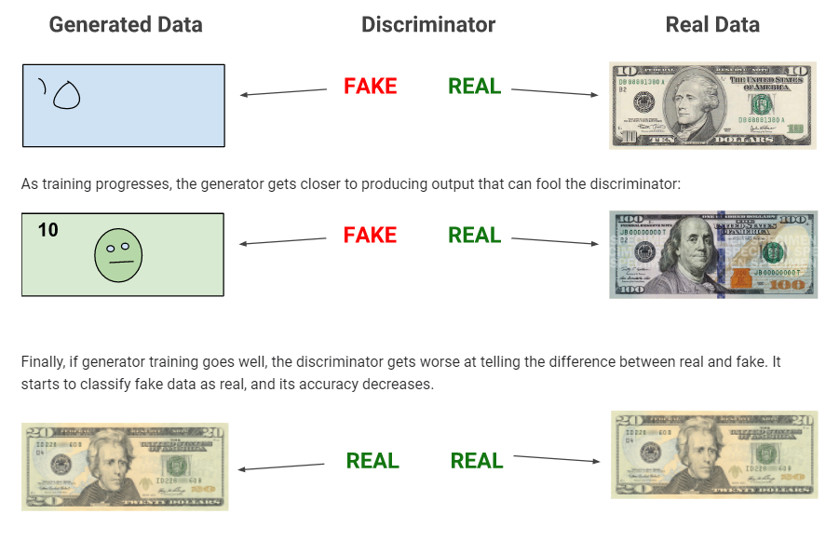
Synthesising Media:
Synthesising media is done by GAN. GAN operates on two components namely: Discriminator and Generator.
The forgeries are created by Generative model using a data collection of example videos, while the other attempts to recognize if the video is a fraud.
When the Discriminative model cannot detect if the video is phony, the deepfake is presumably convincing enough to a human viewer as well.

Slide 4
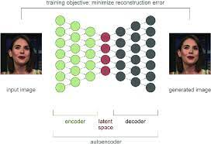
Optimal Algorithm For Deepfakes:
Deepfakes can be created using a variety of GANs. The "autoencoder" is the most popular type of neural network used in deepfakes:
It begins by converting an input image into small sets of numerical values.
Encoding takes place in a sequence of layers that begin with a large number of variables and gradually decrease in size until they reach a "bottleneck" layer. The target number of variables is contained in the bottleneck layer.
Finally, the neural network reconstructs the original image by decoding the data in the bottleneck layer.

Slide 5
How to differentiate between Real and Fake?
Use cases of synthetic media
Unnatural eye movement.
Unnatural facial expressions.
Awkward facial-feature positioning.
Awkward-looking body or posture.
Hair that doesn’t look real.
Images that look unnatural when slowed down.
Digital fingerprints.
Reverse image searches.
Pay attention to blinking.
Replacing or synthesizing faces and speech.
Potential usages in the movie industry.
Entertainment purposes.
Filters on social media
Education to deliver more engaging online lectures
Animation/Gaming and Mixed Reality

